Slide 1
PowerShell Fundamentals for the Absolute Beginner

Slide 2

Get-Help –Name ‘about_Presenter’
Mike F Robbins
Microsoft MVP
SAPIEN Technologies MVP
Leader & Co-Founder of Mississippi PowerShell User Group
Co-Author of Windows PowerShell TFM 4th Edition
Author of Chapter 6 in the PowerShell Deep Dives book
Winner of the Advanced Category in the 2013 Scripting Games
Learn more about me @ mikefrobbins.com

Slide 3
Write-Output ‘Questions for Audience’
IT Pro’s
Developers
PowerShell
One-Liners
Scripts
Functions
Modules
.NET Framework
Source Control
Unit Testing

Slide 4

Set-Content ‘Information to Cover’
Basics
Discoverability
Objects
Methods
Properties
Pipeline
Extending PowerShell
Remoting
Best Practices
SQL Server

Slide 5
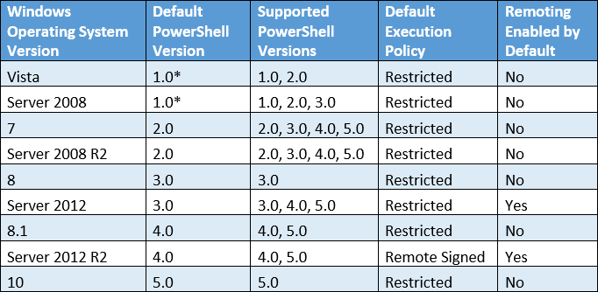
Supported PowerShell Versions by OS

Slide 6
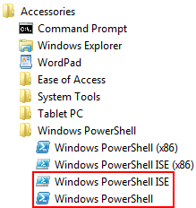
How do I Start PowerShell?
Windows 7 / Server 2008 R2 and Prior OS’s
Start > All Programs > Accessories > Windows PowerShell

Slide 7
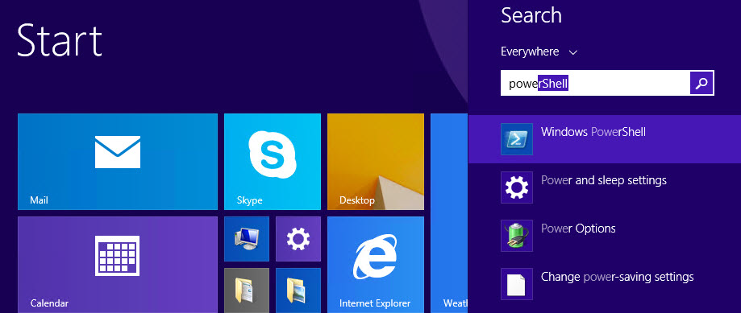
How do I Start PowerShell?
Windows 8, Windows 8.1, Server 2012, & Server 2012 R2
Accessed from the Start screen:

Slide 8
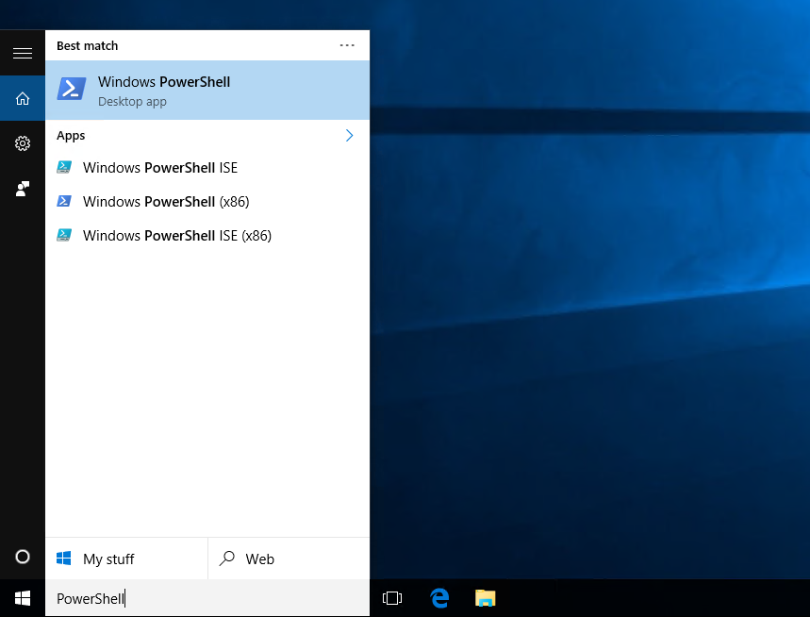
How do I Start PowerShell?
Windows 10

Slide 9
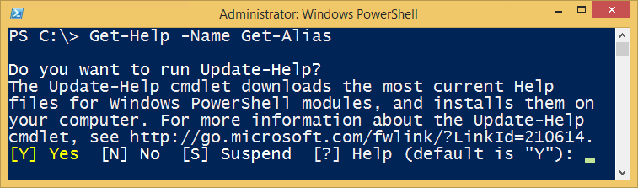
Background Information
PowerShell Commands are called Cmdlets
Cmdlet is pronounced command-let (not CMD-let)
Cmdlets are in the form of singular Verb-Noun commands
Select “Run as Administrator” when opening PowerShell
PowerShell is unable to participate in User Access Control (UAC)
Updatable Help

Slide 10
How Do I Figure Out What the Commands Are?
Core Commands for Discovering How to Use PowerShell
Get-Command
Find what commands are available
Get-Help
Figure out how to use commands
Get-Member
Discover Objects, Properties, and Methods

Slide 11
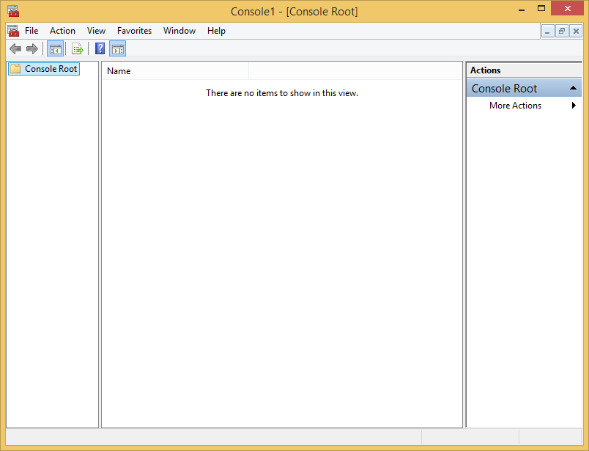
PowerShell is like the Microsoft Management Console (MMC)

Slide 12
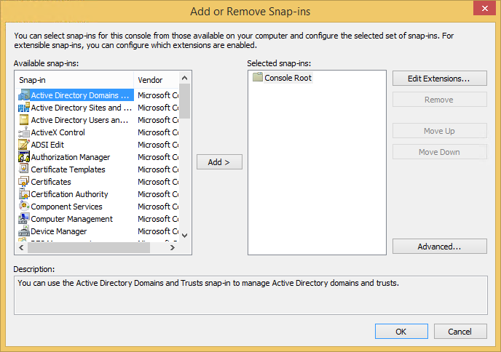
Snap-ins (and Modules) extend its functionality

Slide 13
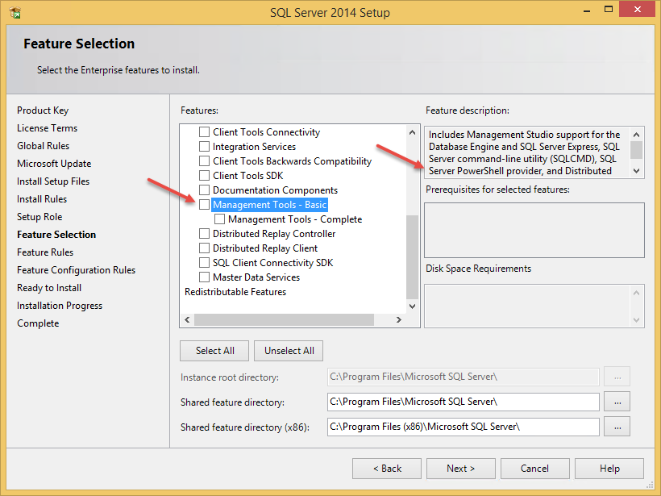
Install the SQL PowerShell Module (Old)

Slide 14
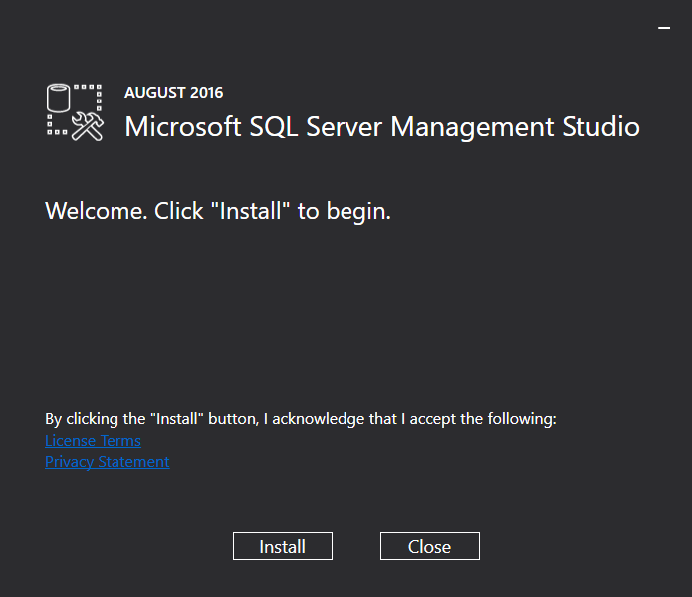
Install the SQL PowerShell Module (New)

Slide 15

Start-Process ‘Demo’
Demo Code: github.com/mikefrobbins/Presentations

Slide 16
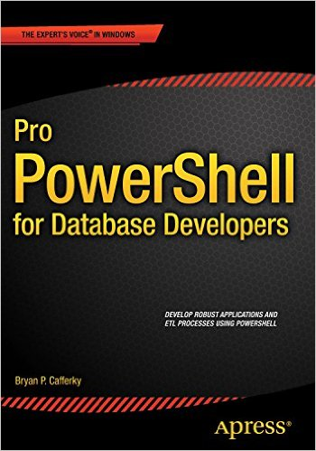
Select-Object –Property ‘Resources’
PowerShell.org
PowerShell Virtual Chapter of SQL PASS
Microsoft Virtual Academy
User Groups
Twitter
GitHub
Blogs
PowerShell Best Practices and Style Guide
Trello
Slack

Slide 17
Thanks for Attending SQL Saturday Baton Rouge 2016!
Speaker evaluations: Use the small square cards at the front of the classroom, give directly to speaker.
Speaker: Please give out 1 book ticket
Book Ticket Winner: Bring your ticket to the user group booth in the main atrium to redeem (supplies limited)

Slide 18




Slide 19

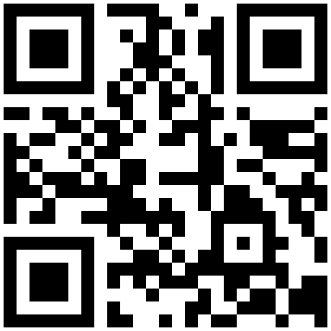

Get-Contact –Identity ‘Presenter’
Blog: mikefrobbins.com (or MrPowerShell.com)
Twitter: @mikefrobbins
LinkedIn: www.linkedin.com/in/mikefrobbins
E-Mail: See mikefrobbins.com/about/
User Group: mspsug.com (or MsPowerShell.com)

